Slide 1
Capstone Project - 1
Telecom Churn Analysis
Team Members Pratik Vishwakarma Ashraf Ali Korbu Mohammed Saad Pasha Nayanjyoti Sharma Arunav Goswami

Slide 2
Introduction
Churn : It is a problem for Telecom companies as it is more expensive to acquire new customers than to keep the existing ones from leaving.
Company : Orange S.A., formerly France Telecom S.A., is a French Multinational telecommunications corporation.
It has 266 million customers worldwide and is the 11th largest mobile network operator in the world.
Data set : The data set given is for the country USA, consisting of all 51 states. And the data set is of .csv format.

Slide 3
Project Objectives
To discover key factors responsible for customer churn.
Perform EDA (Exploratory Data analysis) on different Variables present in the data set.
To come up with ways or recommendation to ensure customer retention.

Slide 4
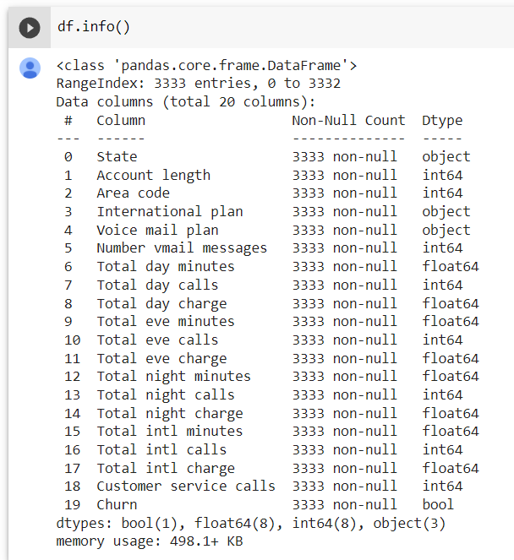
Data set description
There are a total of 3333 numbers of Rows present in the data set.
The total number of columns present is 20.
There are no missing values.

Slide 5
Data Summary
Account length
Customer service calls
Number Vmail messages
Total day minutes
Total day calls
Total day charge
Total eve minutes
Total eve charge
Total eve calls
Total night minutes
Total night calls
Total night charge
Total intl calls
Total intl charge
Total intl minutes
Churn
Target
Numerical
Telecom Data
Categorical
State
International plan
Voice mail plan
Area code

Slide 6

EDA (Exploratory Data Analysis)
Exploratory Data Analysis is an approach to analyze data sets and to summarize their main characteristics, often with visual methods.
Data visualization using Matplotlib and Seaborn.
Performing EDA helps in seeing what the data can tell us.

Slide 7
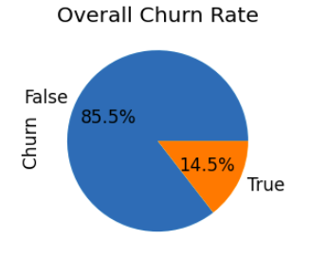
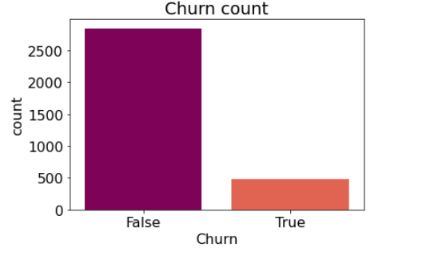
EDA (continued)

Slide 8
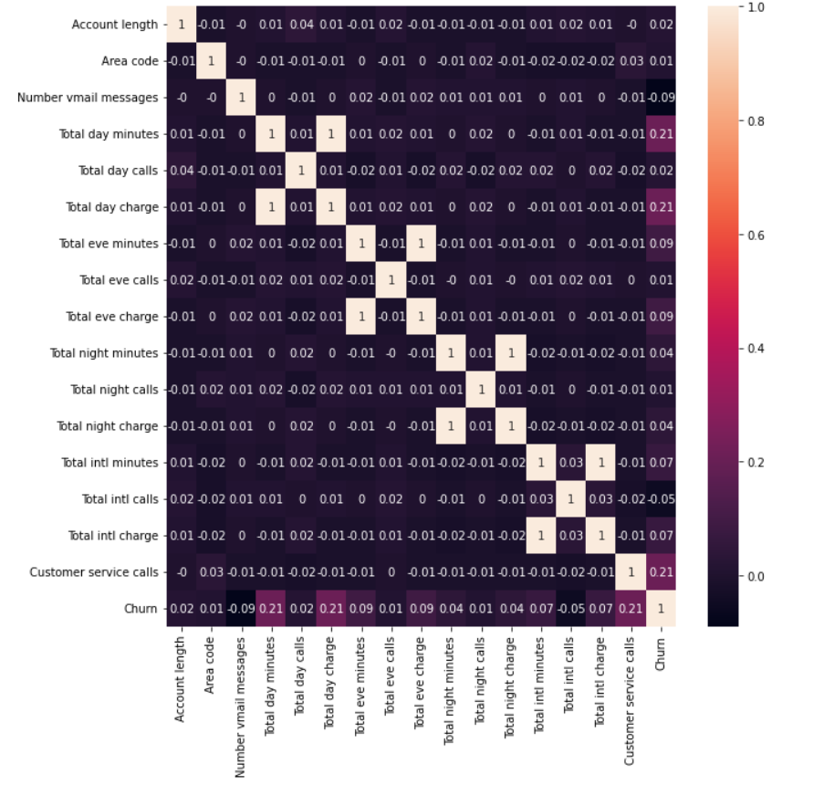
EDA (continued)

Slide 9
EDA(continued)

Slide 10
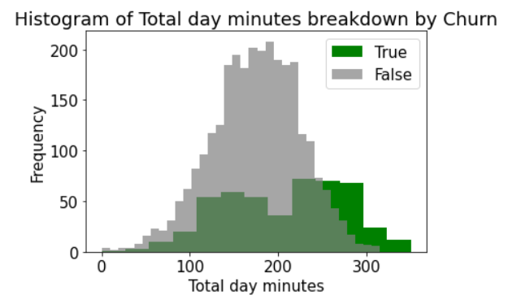
EDA(continued)

Slide 11
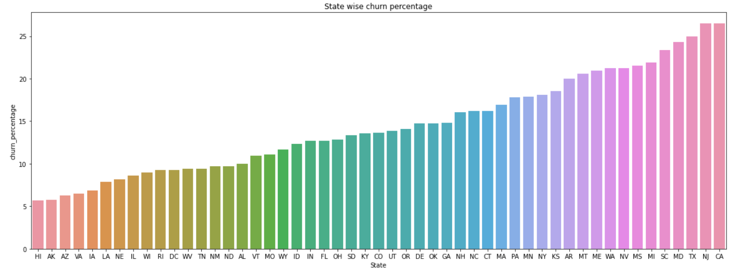
EDA (continued)
State wise churn percentage:-

Slide 12
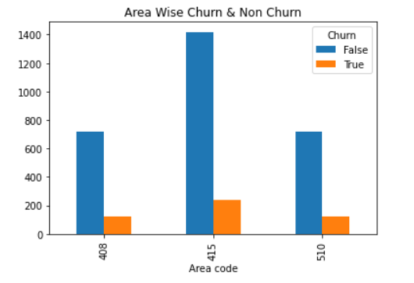
EDA (continued)

Slide 13
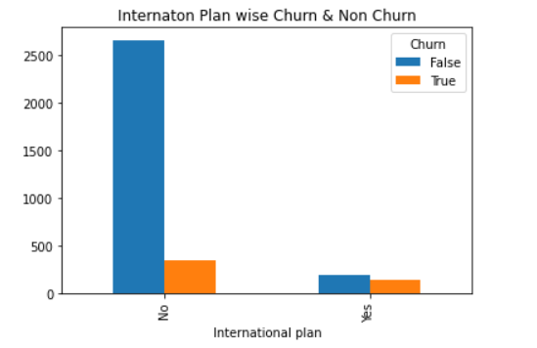
EDA (continued)
11.5 % churn rate for no international plan & 42.41 % for international plan

Slide 14
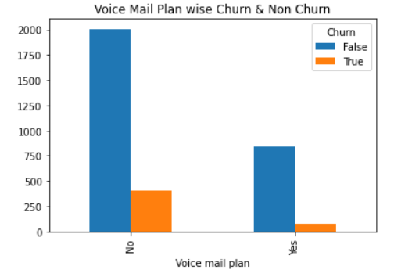
EDA (continued)
16.7 % churn rate for no voice mail plan & 8.6 % for voice mail plan

Slide 15

Observations
Churn rate increases with increase in customer service calls
Customers with longer talk time in the morning have high chance of discontinuing the subscription.
High populated areas have high churn rate.
Customers with international plan have high chance of leaving the subscription.
For customers with no voice mail plan, the chance of discontinuing the subscription is greater than those with voice mail plan.
Try to offer the best

Slide 16

Conclusion
From the observations, we can conclude that the company needs to work on the following fields for customer retention:
Offer better service in most populated areas.
Provide better long talk time plans.
Take feedback and suggestions on a regular basis, try to implement it and strive for better communication.
Company can offer better International plans.
Offer more Incentives in the form of discounts and cashbacks to churn customers

Slide 17

Challenges
Selection of features was quite a challenge.
For some of the variables like ‘Account length’, we have no idea about its relevance to Churn.
We cannot consider all these variables as the exact reasons why customers left because they might leave for the better price offered by competitors or the bad economy at a certain time, etc.
Churn does not take into consideration the types of customers that are leaving – new vs old

Slide 18
Thank You

